Slide 1
Digital Fundamentals
数 字 概 念
延 边 大 学 工 学 院
计 算 机 科 学 与 技 术 专 业
王 晓 丹

Slide 2
课程介绍
学分：3学分
总学时： 56，其中实验8学时（待定）
平时成绩：学习通积分、期中考试、实验等
期末考试：闭卷机考
近期要求：每周一发布学习任务；双周周三21:00有直播或者测验（务必在线）。

Slide 3
Ch1: Digital Concepts(数字概念)
1.1 Digital and Analog Quantities
(数字量和模拟量)

Slide 4
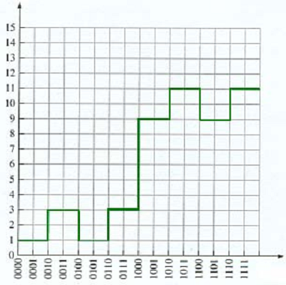
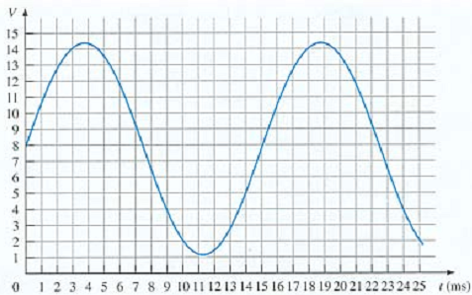
Digital and Analog Quantities
Analog quantities have
continuous values
Digital quantities have
Discrete sets of values

Slide 5
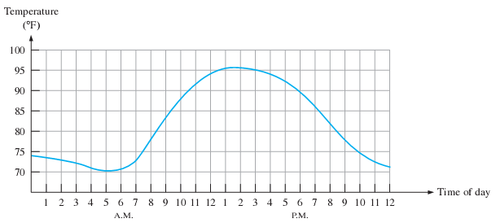
Graph of an analog quantity
- Temperature versus time

Slide 6
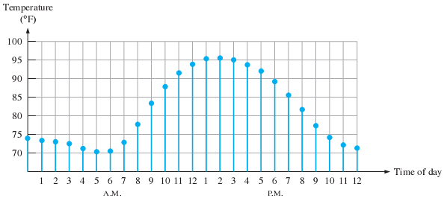
Sampled-value representation of the analog quantity
- Each value represented by a dot can be
digitized by representing it as a digital code
that consists of a series of 1s and 0s

Slide 7
Digital and Analog Quantities
Types of electronic devices or instruments:
- Analog
- Digital
- Combination analog and digital

Slide 8
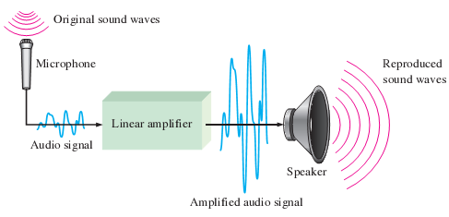
A basic audio public address system

Slide 9
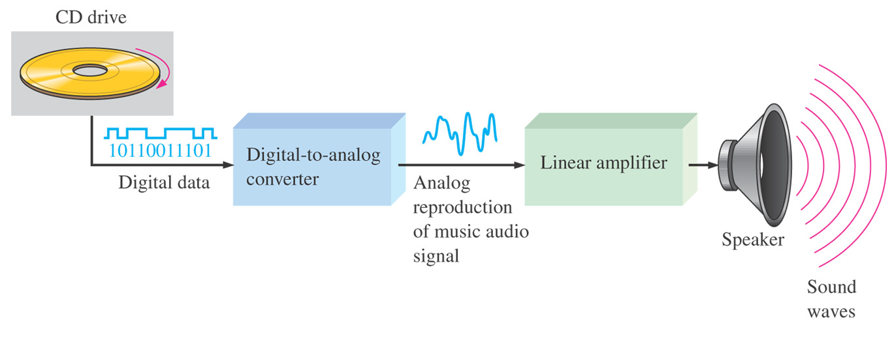
Basic block diagram of a CD player

Slide 10
The Digital Advantages in Electronics Application
Digital data can be processed and
transmitted more efficiently and reliably
than analog data.
2. Digital data has a great advantage when
storage is necessary

Slide 11
Section1.1 Review
Define analog.
Define digital.
Explain the difference between a digital
quantity and an analog quantity.
4. Give an example of a system that is
analog and one that is a combination of
both digital and analog. Name a system
that is entirely digital.

Slide 12
1.2 Binary Digits, Logic Levels,
and Digital Waveforms
(二进制数，逻辑电平和数字波形)

Slide 13
Binary Digits
计算机存储数据的基本单位是字节（byte）
最小单位是位（bit）
位=二进制: 0 and 1

Slide 14
Binary Digits
- The two binary digits (bit) can also be
called LOW and HIGH
Positive Logic(高电平): HIGH = 1
Negative Logic(低电平): LOW = 0

Slide 15
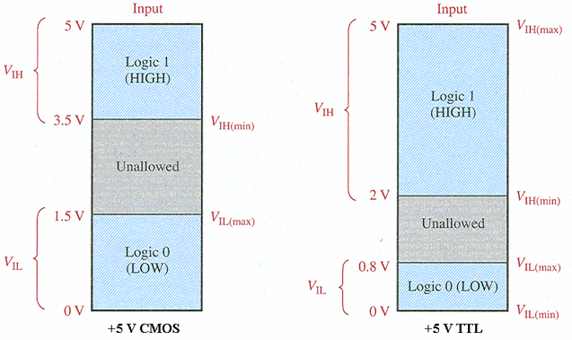
Logic Levels
不允许的区域
不允许的区域

Slide 16
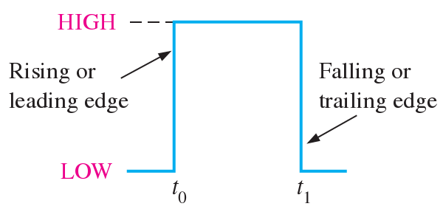
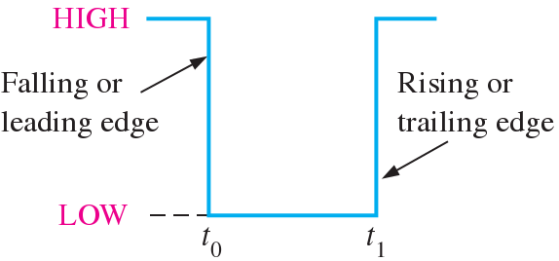
Ideal Pulses(理想的脉冲)
上升沿
下降沿
Positive-going pulse
(正向脉冲)
(b) Negative-going pulse
(负向脉冲)

Slide 17
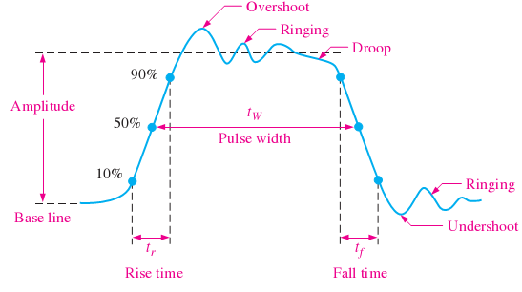
Nonideal pulse characteristics
Major parts of a digital pulse
- Base line(基线)
- Amplitude(幅值)
- Rise time
(上升时间)
- Pulse width
(脉冲宽度)
Fall time
(下降时间)

Slide 18
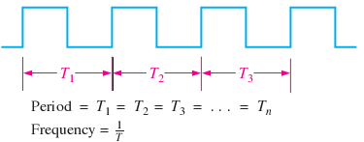

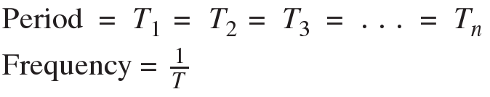


Digital Waveforms

Slide 19
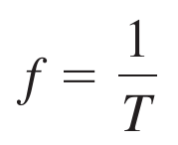
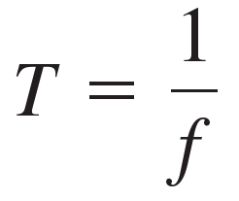
Digital Waveforms
f: frequency(频率)
T: Period(周期)

Slide 20

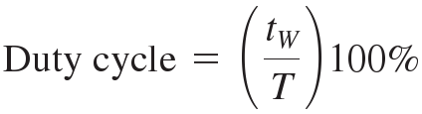
Digital Waveforms
Duty cycle: 占空比
tw: 脉冲宽度
T: Period(周期)

Slide 21
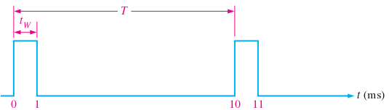
Example 1.1
A portion of a periodic digital waveform is
shown in Figure 1-9. The measurements are
in milliseconds. Determine the following:
(a) period (b) frequency (c) duty cycle

Slide 22
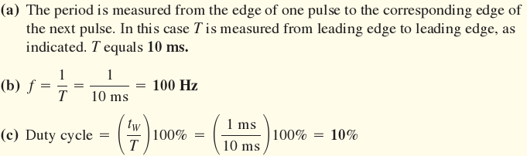
Example 1.1 (solution)

Slide 23
A Digital Waveform Carries Binary Information
The Clock: In digital systems, all waveforms
Are synchronized with a basic timing wave-
Form called the clock.(时钟，脉冲，时脉)

Slide 25
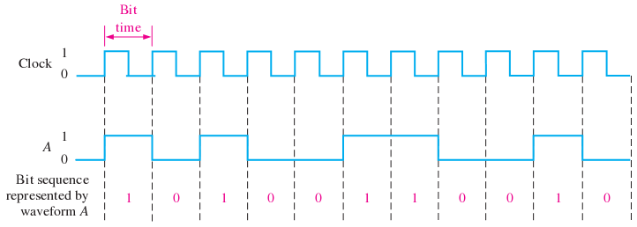
Example of a clock waveform
Synchronized with a waveform representation of a sequence of bits

Slide 26
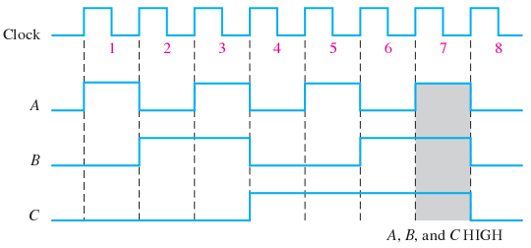
Timing diagram(时序图)

Slide 27
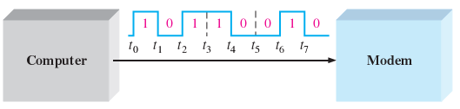
Data Transfer (Serial)

Slide 28
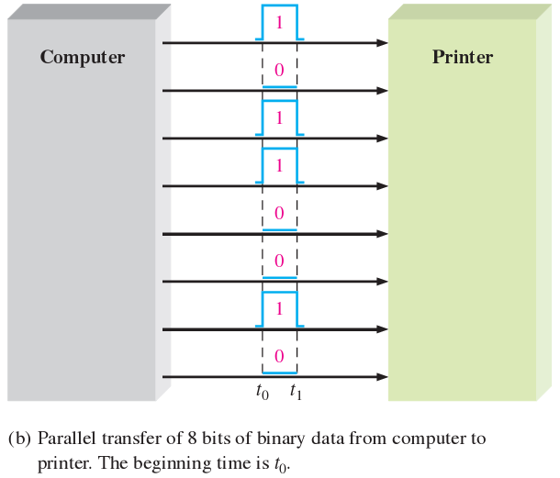
Data Transfer (Parallel)

Slide 29
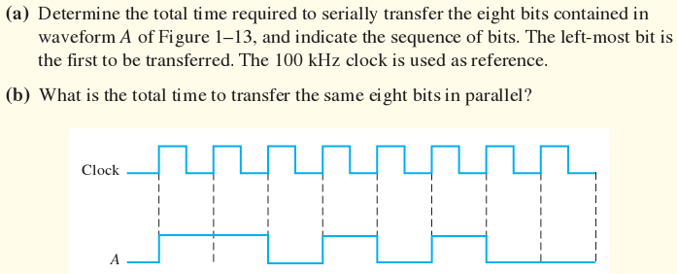
Example

Slide 30
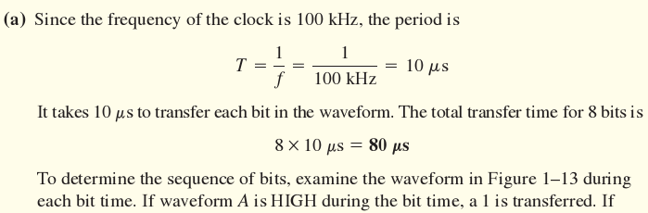
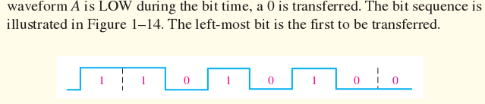
Solution

Slide 31
- Define binary (定义二进制)
Define bit (定义位)
Name the bits in a binary system (确认二进制系统中的位)
Explain how voltage levels are used to represent bits (说明电压电平如何表示位)
Explain how voltage levels are interpreted by a digital circuit (解释数字电路是如何表示电压电平的)
Describe the general characteristics of a pulse (描述脉冲的一般特性)
Determine the amplitude, rise time, fall time, and width of a pulse (确定脉冲的幅度，上升时间，下降时间，及宽度)
Identify and describe the characteristics of a digital waveform (判断并描述数字波形的特性)
Determine the amplitude, period, frequency, and duty cycle of a digital waveform (确定数字波形的幅度，周期，频率和占空比)
Explain what a timing diagram is and state its purpose (解释什么是时序图及其用途)
Explain serial and parallel data transfer and state the advantage and disadvantage of each (解释串行和并行数据传输，并说明它们各自的优点和缺点)

